Slide 1
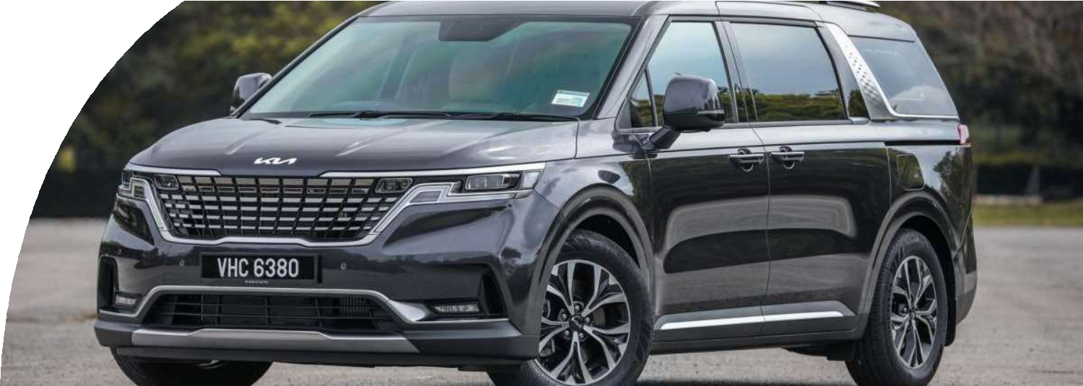







Advertising & Integrated Brand Promotions
Submitted to: Dr. Ajeet Sharma
Submitted by: Group 1
Aruza, Renu Sree, Pearly, Pallav and Ujjwal

Slide 2




Company Overview
Kia came to India with a vision to win the hearts of the
young car buyers with our futuristic products and dynamic designs which are inspired by India. With our Badass By Design Seltos, Extravagant By Design Carnvial and
#WildByDesign Sonet we have surprised the Indian car buyers and revolutionized the Indian Automobile industry. Kia Motors Corporation's brand slogan – "The Power to
Surprise" – represents the company's global commitment
to surprise the world by providing exciting and inspiring
experiences that go beyond expectations.
Kia has a market share of about 6 percent in just 2.5 years and is among the top 5 automakers of India sales wise.
New Slogan- Movement that inspires

Slide 3

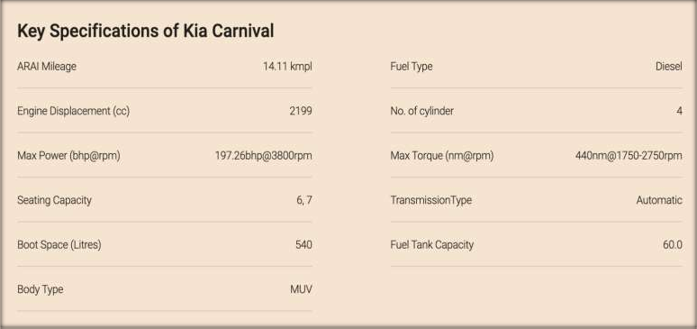
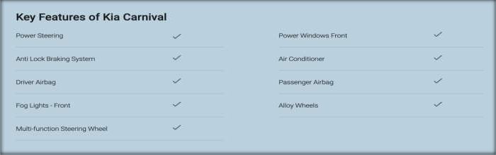

Slide 4

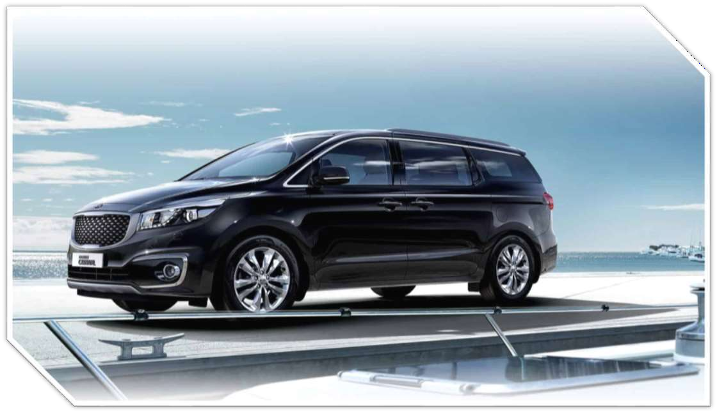

Slide 5

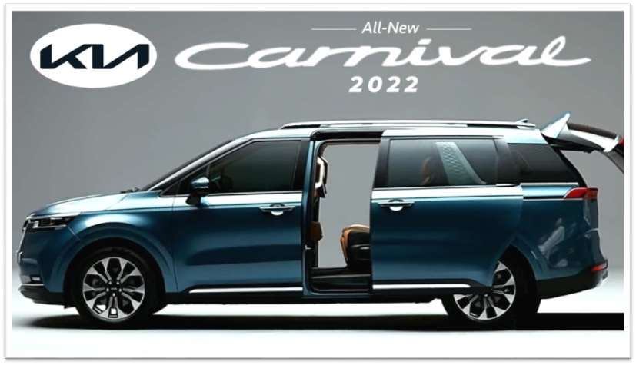
Spotify
Digital Billboard
TVC & Social Media
Newspapers (Print Media)
Media
channels

Slide 6

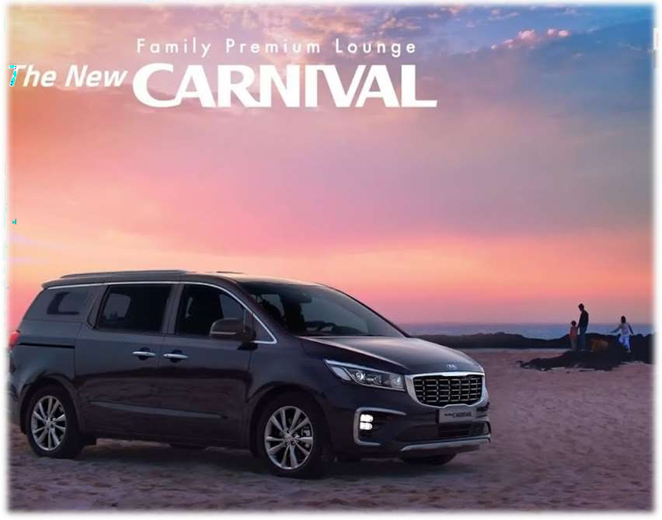






AD Budget - 6.8 crores
Time- 2 months
TA- Gender – women,
Age group- 30-60,
Income- middle (EMI) & high,
Location- tier-1 & tier-2 cities
Project objective- To create an advertisement that will create
brand awareness in the consumers of the age group 30- 60 with 40% change in 2 months period.

Slide 7


Spotify Ad for Kia Carnival
Client Name: Kia India Private Limited
Project: “An ad to position Carnival as a Family Mover”
Objective: To create awareness amongst traveling women in the age group 30-60 years, with the
change of 40%, in a period of 2-3 months after the start of the ad.
Market: Innova Crysta, Toyota Fortuner, Hyundai Alcazar, XUV 700. Innova Crysta holds a 52.91% market share of the segment.
Client Background & goals: Kia India Private Limited is a subsidiary of Kia for its operations in India. The company was founded on 19 May 2017 following an announcement of the construction of a new 536-acre manufacturing facility in Anantapur District, Andhra Pradesh.
Steps Needed to Accomplish Goals of Audio (30 sec.)
Script needs to be written/improved
How long is the Script – 30 seconds
Target audience: Gender – women, Age group- 30-60, income- middle & high, tier-1 & tier-2 cities.
Product positioning:
Moving people in luxury
space, the comfort and luxury it promises the rear passengers
premium-ness of experience
Major selling idea: “A journey well shared is a journey well enjoyed- Women travel the world”
Brand Personality: Kia Carnival is considered to be a plush people mover or party central on wheels.
Does the product solve any consumer problem? Customers can get the car customized to suit their tastes,
preferences and needs.

Slide 8

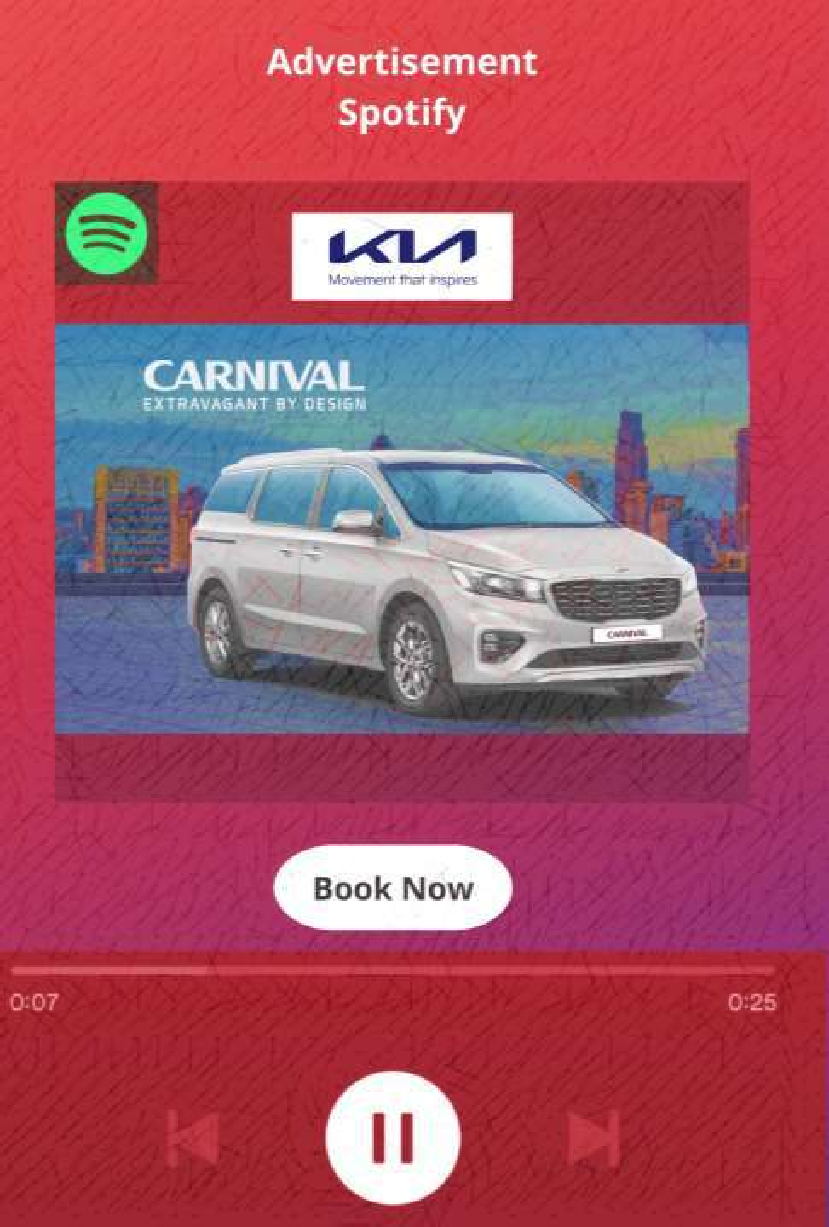
Message/ tone: Music appeal & adventure appeal - A group of working women decides on an adventure trip
with music having highbeats playing on background and one woman sharing Kia carnival features.
Media: Spotify
Anything included/ avoided in ad: features of kia carnival should be mentioned.
Client's budget: 70,000 – 80,000 per ad set and average CPM (cost-per-thousand-impressions) of 1500-2000.
Delivery timelines: 30 seconds during 7pm to 10pm Time period of the ad going on media: 2-3 months Coverage: Tier-1 and Tier-2 cities
How will the ad be measured over a period of time: Ad delivery metrics like ads served, reach, frequency, and completion rate can be measured using Ad Studio, Spotify's self-serve ad manager.
Script for spotify audio ad:
Client: Kia India Private Limited
Brand: Kia Carnival Length:30 seconds
SFX- Audio-Adventurous music
Woman1: Let’s take a break and go on an adventure.
Woman2: Great idea. But we are 7 people. Where do we find a vehicle that suits our needs?
Woman3: Don’t worry about that. Let’s go in my new Kia Carnival.
Woman1: Is it comfortable for all of us?
Woman3: Kia Carnival has dual sunroof, one-touch power sliding doors, Projector bulb headlamps & Fog lamps, Premium Leather Seats, LED Rear combination lamps and many more. You can also get your Kia Carnival customized to suit your preferences.
Woman2: Perfect, Let’s go!!!
VO: Click on this link to visit Kia Carnival website for more info.

Slide 9

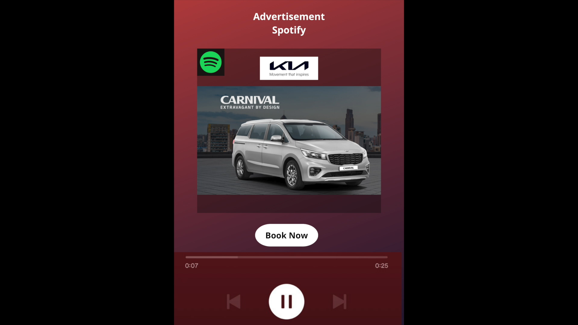

Slide 10

Billboard Ad for Kia Carnival
Client Name: Kia India Private Limited
Project: “An ad to position Carnival as a Family Mover”
Objective: To convince at least 60% of the TA travelling daily on the roads, in period of 3 months after the start of the ad, that the brand car is spacious and full of features.
Market: Innova Crysta, Toyota Fortuner, Hyundai Alcazar. Innova Crysta holds a 52.91% of the segment.
Client background: Kia India Private Limited is a subsidiary of Kia for its operations in India. The company was founded on 19 May 2017. The US$2 billion manufacturing plant is capable of producing
300,000 vehicles annually. The Kia Carnival was first launched in the Indian market at the 2020 Auto Expo.
Target Audience: Working Women aged from 30 to 60 with high income.
Product Positioning: Spacious, Feature-Loaded and easy to Drive Car.
Major Selling Idea: Be the woman who moves her World.
Brand Personality: Kia Carnival is considered to be a plush people mover or party central on wheels.
Does the product solve any consumer problem? Customers can get the car customized to suit their tastes, preferences and needs.
Message/Tone: Kia Carnival - being long and spacious, is easy to Drive with the features offered with a short video showing all the prime features of the car.
Media: Digital billboard
Anything Included: Adequate time and font for the consumer to read.
Client Budget for your Medium: Rs.2,65,000 15 days MG Road - Rs.2,25,000 per month
Airport Road – Rs.1,25,000 per month JP Nagar – Rs. 1,30,000 per month Silk board – Rs.50,000 per month Delivery Timelines: 15 Days
Time Period: 3 Months
Coverage: Tier 1 Cities

Slide 11

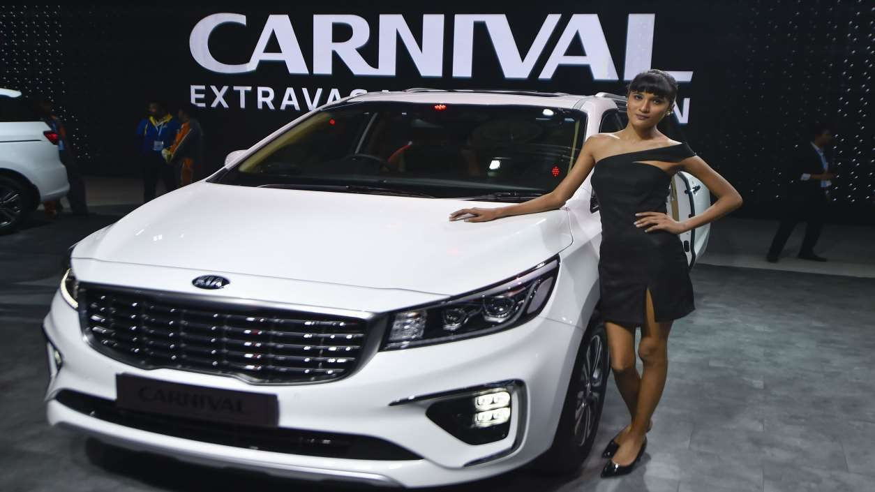

Slide 12
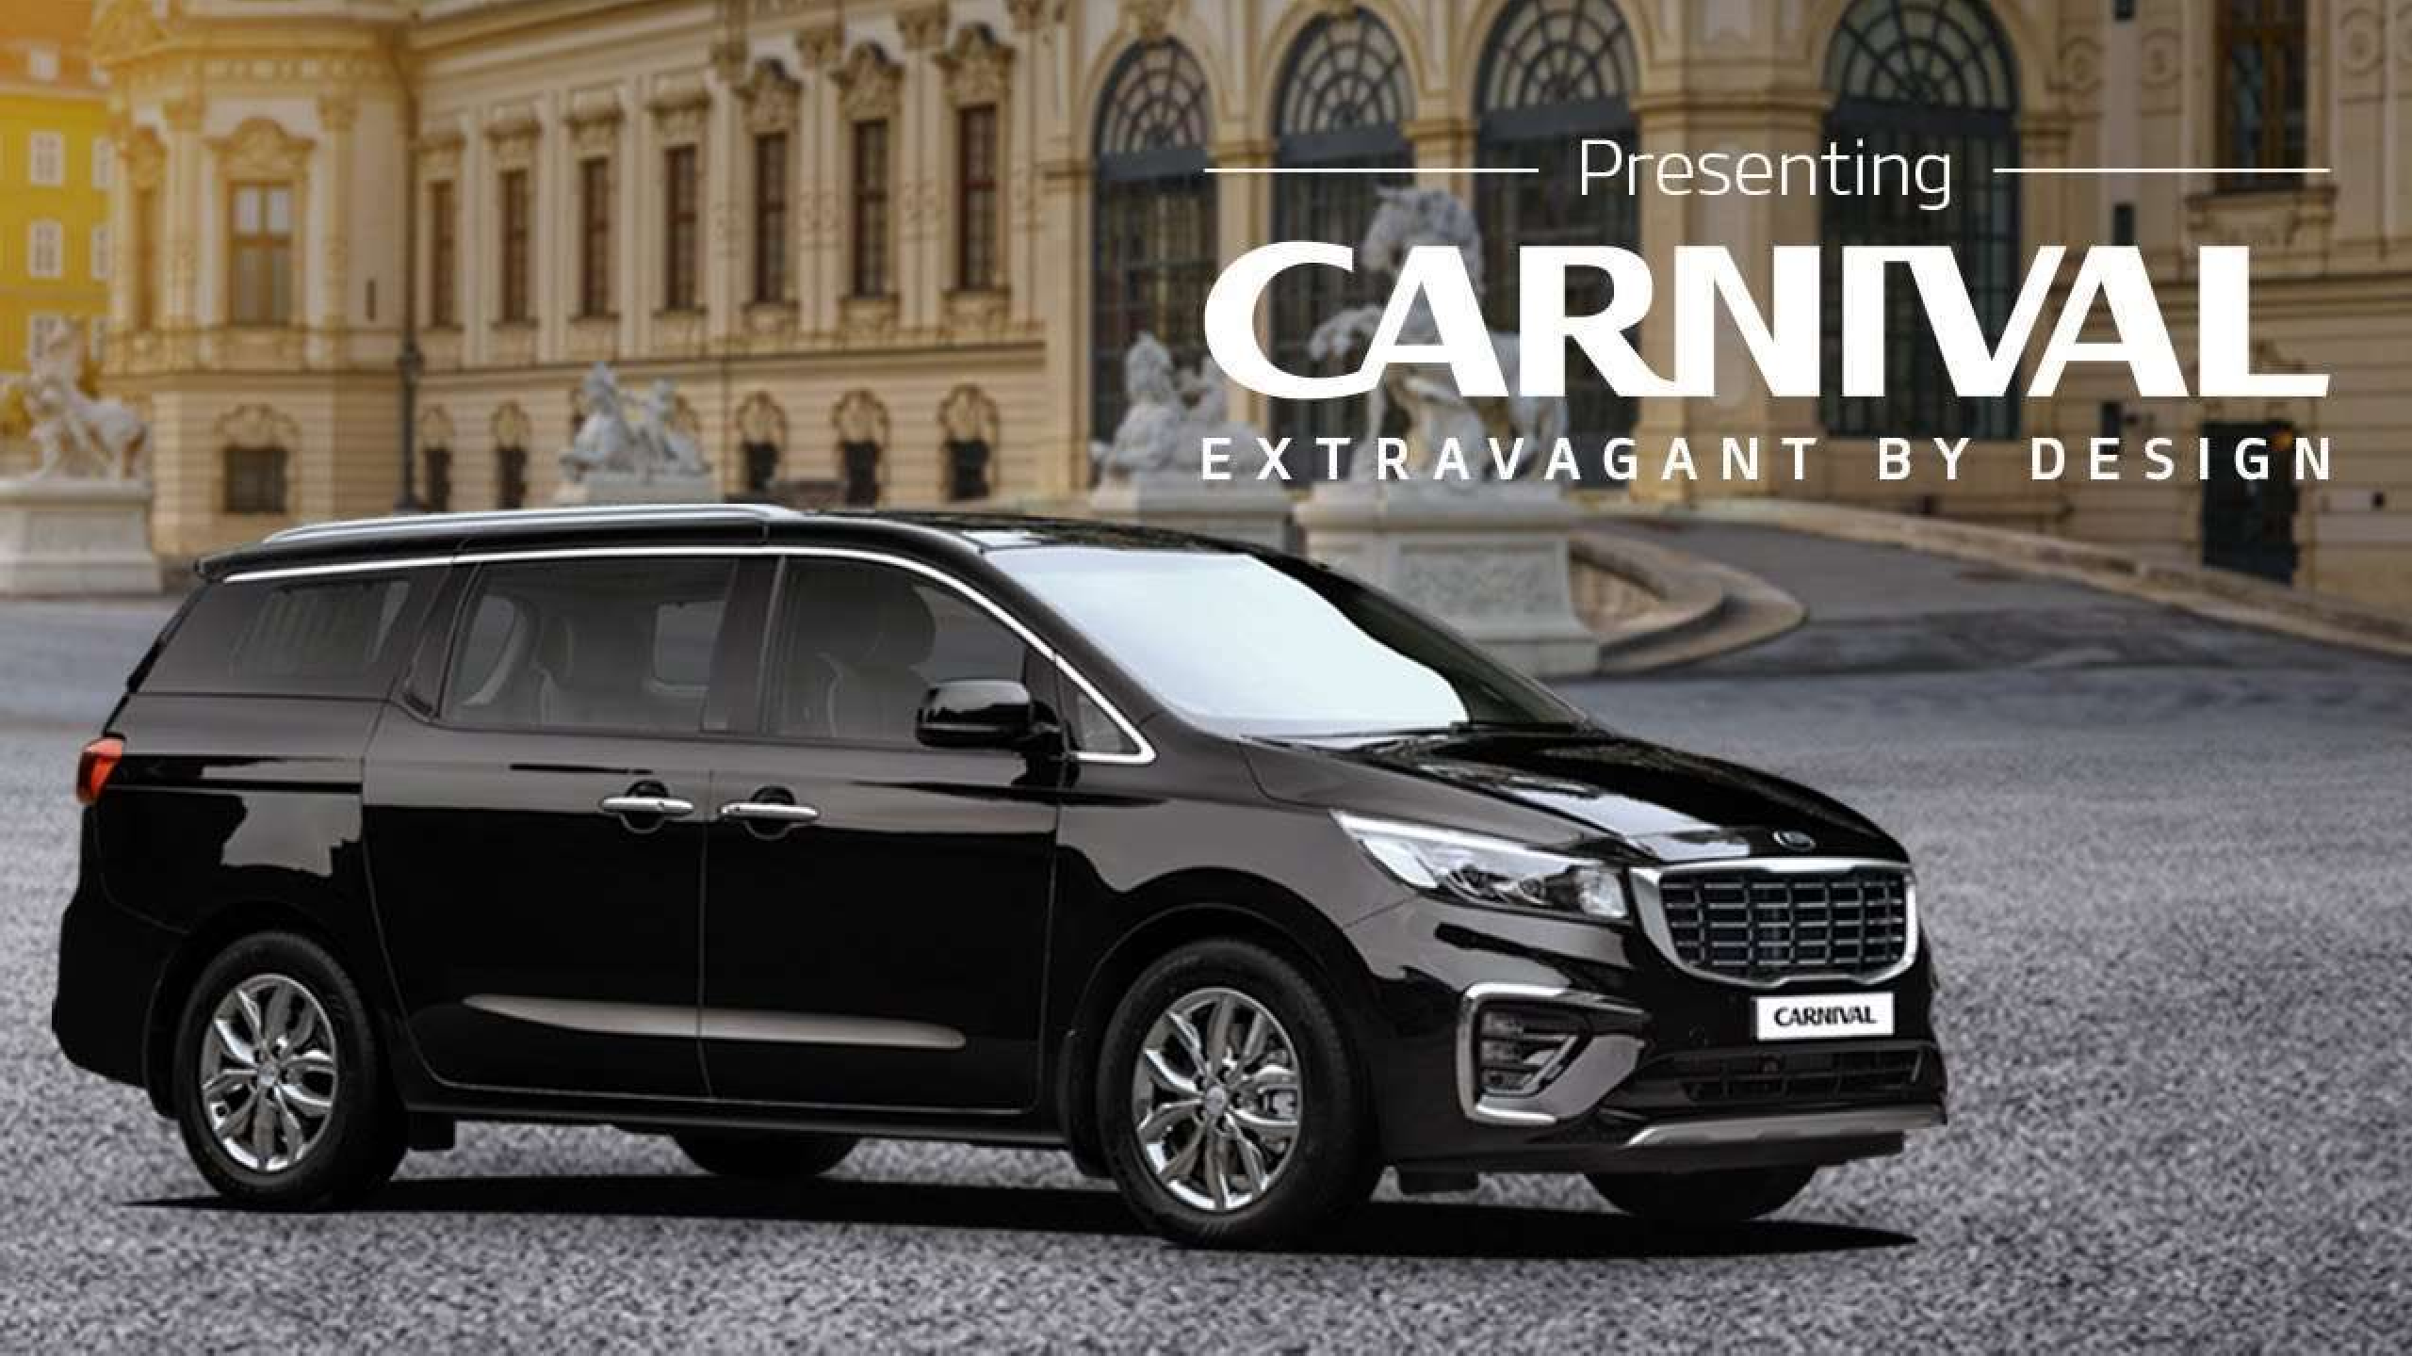
Social Media & TVC

Slide 13

TVC for Kia Carnival
Client Name, Client Info: Kia India Private Limited
Project: “An ad to position Carnival as a Family mover and create awareness about it”
Objective: To create an advertisement which will create brand awareness in the consumers of the age group 30-60 and high income with 65% change in 3-4 months.
Market: Innova Crysta, Toyota Fortuner, Hyundai Alcazar. Innova Crysta holds a 52.91% market share of the segment.
Client background: Kia India Private Limited is a subsidiary of Kia for its operations in India. The company was founded on 19 May 2017. The US$2 billion manufacturing plant is capable of
producing 300,000 vehicles annually. The Kia Carnival was first launched in the Indian market at the 2020 Auto Expo.
Target audience: Gender – women, Age group- 30-60, income- high
Product positioning: Highly customizable and premium MPV with high quality features like multi-zone climate control, sunroof, multiple airbags, latest safety tech, etc.
Major selling idea: ‘Your Happiness is our priority’-Kia Carnival
Brand Personality: Kia Carnival is considered to be a plush people mover or party central on wheels.
Does the product solve any consumer problem? Customers can get the car customized to suit their tastes, preferences and needs.
Message/ tone: Emotional – a women after becoming successful, is purchasing a car that could be customised according to the needs of her family and stand as an inspiration to all the
children from her town.
Media: TV
Anything included/ avoided in ad: aesthetic interior design of car should be highlighted.
Client's budget: approximately 1 Cr for 1 month
Delivery timelines: 30 seconds during Prime time 8:00 pm to 11:00 pm
Time period of the ad going on media: 3-4 months
Coverage: Tier-1 and Tier-2 cities
How will the ad be measured over a period of time: Target Rating Points

Slide 14

SCRIPT TVC
Video | Audio
A Young woman executive dresses in a pant suit
Voice over | Whatever I am today, is because of my parents. Let me become a reason of their happiness and surprise them with my gift.
Goes to Kia showroom
Asks for a car which is luxurious and will be a fit for her big family
Salesperson shows Kia Carnival
Shows the features in detail | Aesthetic music playing in the background
Executive says she liked the car and buys it.
She goes to her town in Kia Carnival
Her parents and neighbours come out in surprise to see who has come.
Executive steps out of car
Parents are elated to see their daughter in a successful position
Executive goes near her parents | This is a small gift to you for all the efforts you had done to make me successful. Come on, Let’s go out for a drive
Executive and family go for a drive
Voice over | Kia Carnival – Your Happiness is our priority. Customizable to suit your needs.

Slide 15

MEDIA PLAN TVC
Channel NDTV India
Spot rate (per
10 sec)
Program
Prime Time with Ravish Kumar
Day
Mon-Fri
Time from
21:00
Time to
22:00
Frequency
4
Total Rate
65,520
1092
ET Now | India Tonight | Mon-Fri | 20:00 | 21:00 | 1600 | 3 | 72,000
ET Now | Autocar India Show | Sat-Sun | 20:00 | 20:30 | 1600 | 2 | 19,200
CNBC TV18 | Young Turks | Sat | 20:30 | 21:00 | 3900 | 2 | 23,400
CNBC TV18 | Mad about markets | Sat | 21:00 | 21:30 | 3900 | 2 | 23,400
CNBC TV18 | India Business Hour | Mon-Fri | 21:00 | 21:30 | 3900 | 1 | 58,500
Sony TV | The Kapil Sharma Show | Sat-Sun | 21:00 | 22:00 | 50000 | 3 | 9,00,000
Colors TV | Dance Deewane | Sat-Sum | 21:00 | 22:45 | 43,500 | 5 | 13,05,000

Slide 16

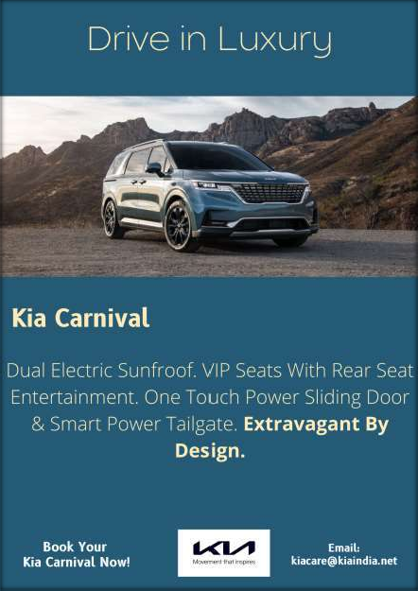





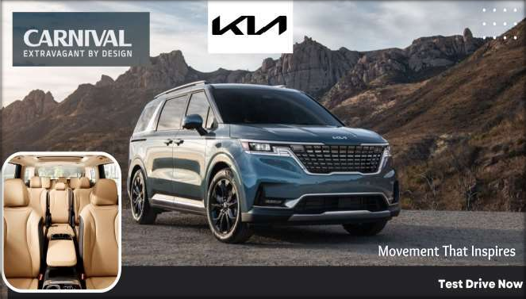

Slide 17

Newspaper for Kia Carnival
Client Name, Client Info: Kia India Private Limited
Project: “An ad to position Carnival as a Family mover and create awareness about it”
Objective: To create an advertisement which will create brand awareness in the consumers of the age group 30-60 and high income with 60% change in 2 months.
Market: Innova Crysta, Toyota Fortuner, Hyundai Alcazar. Innova Crysta holds a 52.91% market share of the segment.
Client background: Kia India Private Limited is a subsidiary of Kia for its operations in India. The company was founded on 19 May 2017. The US$2 billion manufacturing plant is capable of
producing 300,000 vehicles annually. The Kia Carnival was first launched in the Indian market at the 2020 Auto Expo.
Target audience: Gender – women, Age group- 30-60, income- high
Product positioning: Premium and luxurious MPV with best in segment features like power sliding doors, dual sunroof etc.
Major selling idea: Drive in luxury
Brand Personality: Kia Carnival is considered to be a plush people mover or party central on wheels.
Does the product solve any consumer problem? Customers can get the car customized to suit their tastes, preferences and needs.
Message/ tone: Formal tone informing the TA about the features of the car
Media: Newspaper
Anything included/ avoided in ad: Features are to be clearly depicted and mentioned
Client's budget: approximately Rs. 2.6 crores for fortnight
Delivery timelines: twice a week
Time period of the ad going on media: 2 months
Coverage: Tier-1 cities
According to research The economic times paper had a reach of 4.2 million and The Hindu had a reach of 4.6 million readership

Slide 18
The Hindu- Sunday
The economic times – front page – Saturday
Budget- 7,335,000
Delhi- 3085 per sqcm – 18,51,000 (for 600 sq cm)
Mumbai – 3970 per sqcm – 23,82,000 Bangalore – 1260 per sqcm – 7,56,000
Chennai – 1070 per sqcm – 6,42,000
Hyderabad -755 per sqcm – 4,53,000
Kolkata- 1090 per sqcm – 6,54,000
Ahmedabad – 575 per sqcm – 3,45,000 Pune – 420 per sqcm – 2,52,000
Budget- 57,03,000
Delhi – 765 per sqcm – 4,59,000 Mumbai – 485 per sqcm – 2,91,000 Bangalore – 1395 per sqcm – 8,37,000 Chennai – 5715 per sqcm – 34,29,000 Hyderabad – 915 per sqcm – 5,49,000 Kolkata – 230 per sqcm – 1,38,000

Slide 19

THANK YOU

